Slide 1


Slide 2
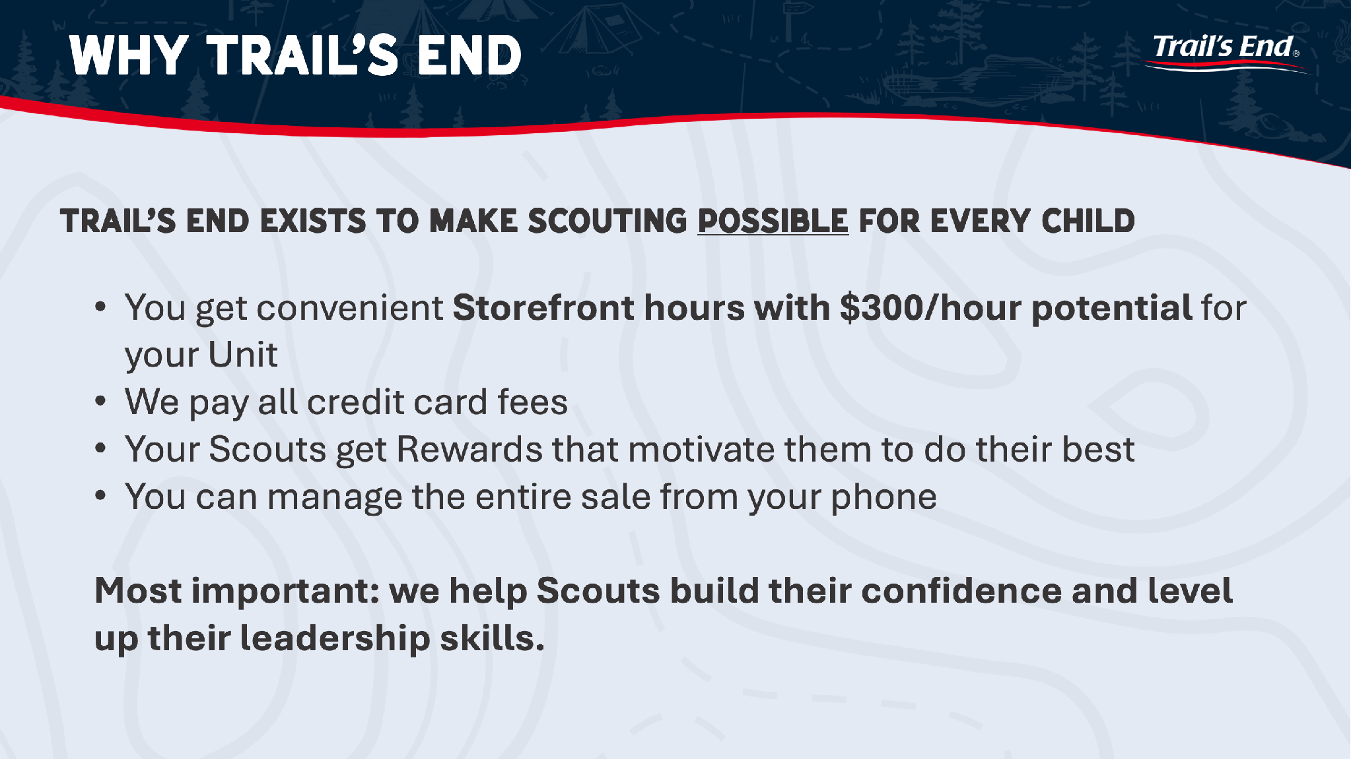

Slide 3
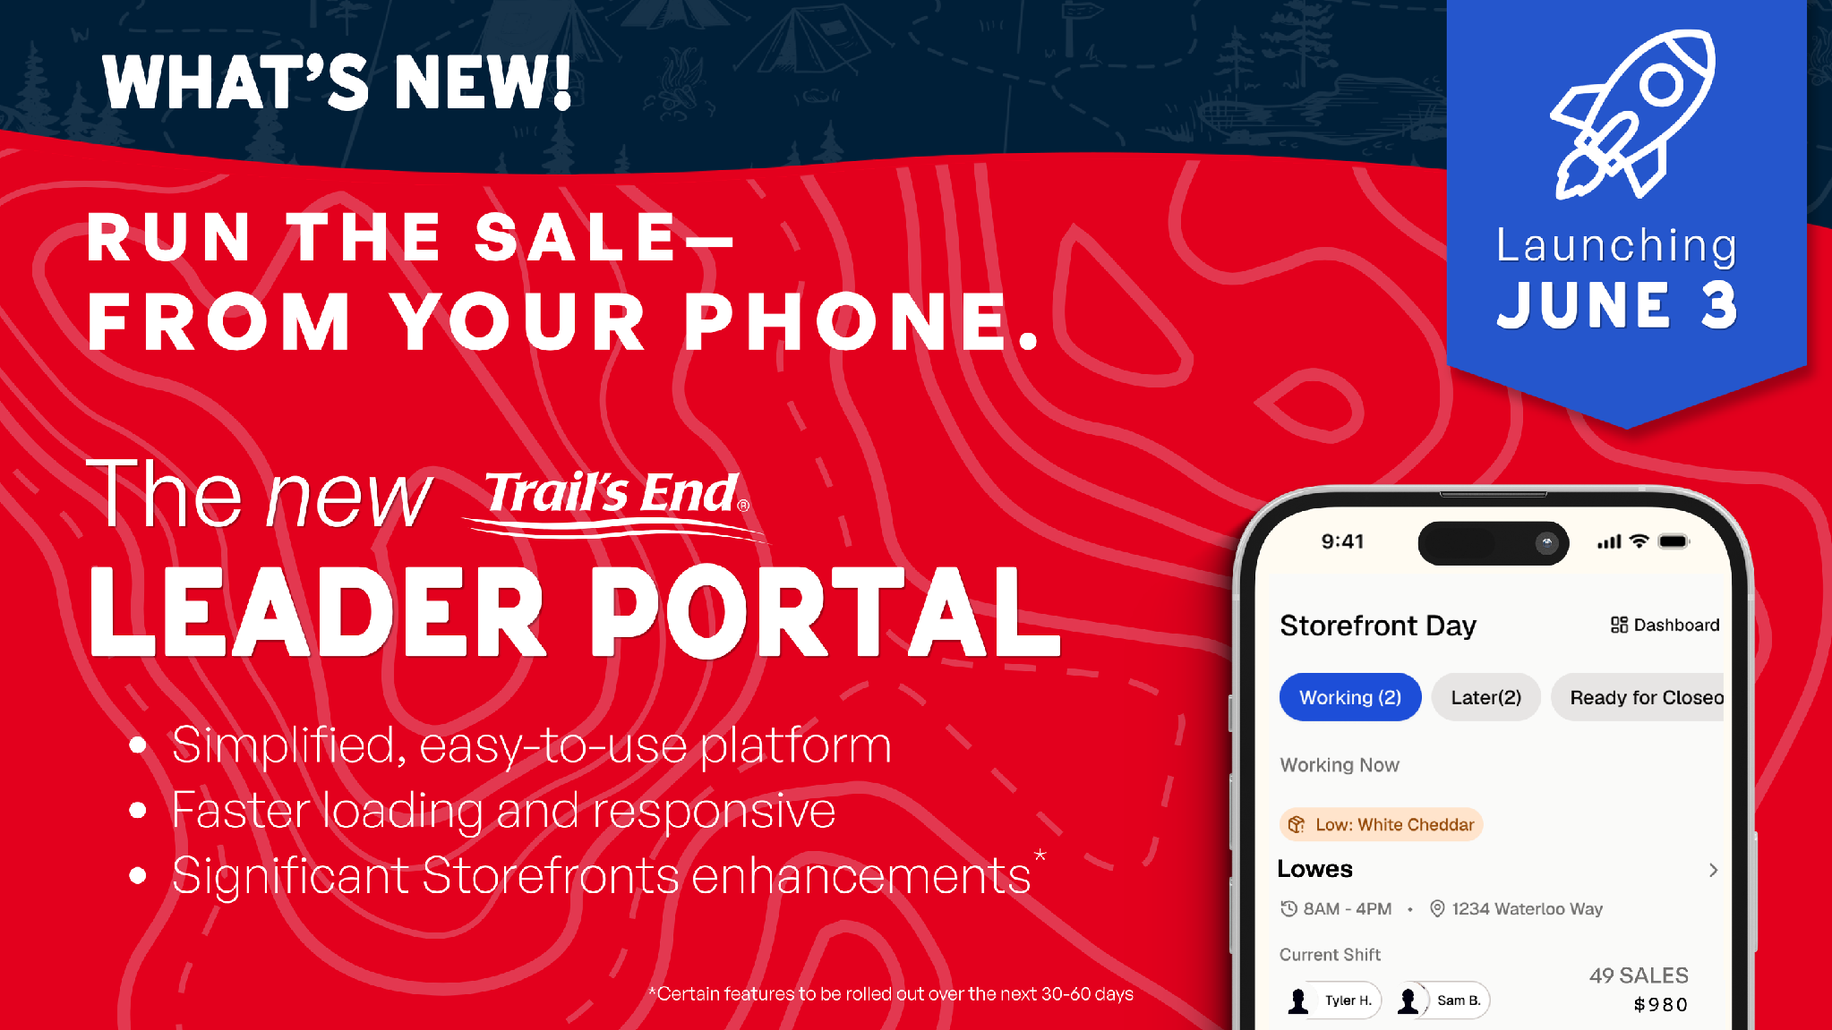

Slide 4
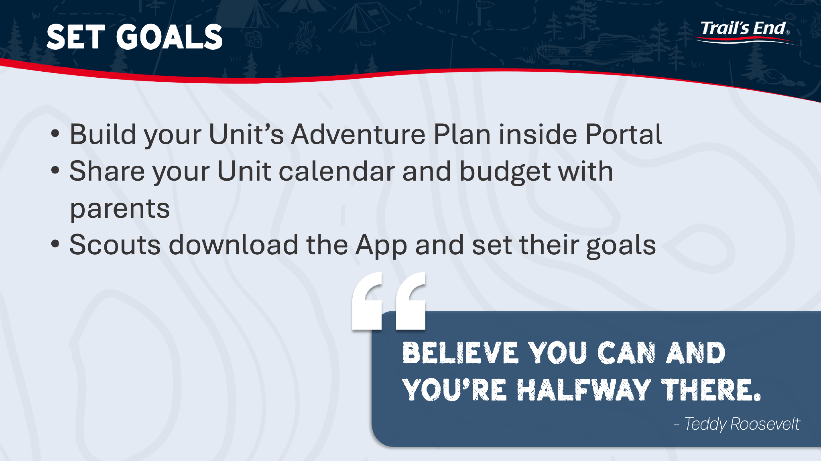

Slide 5
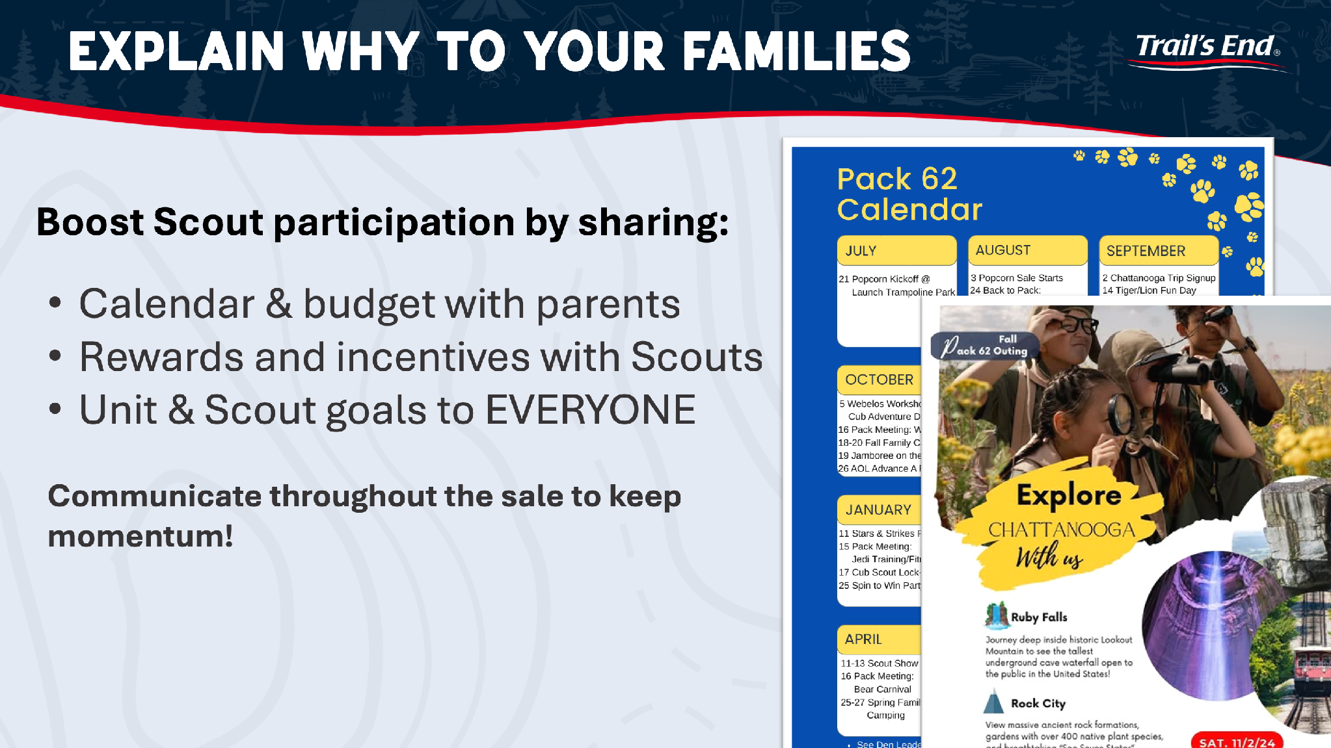

Slide 6
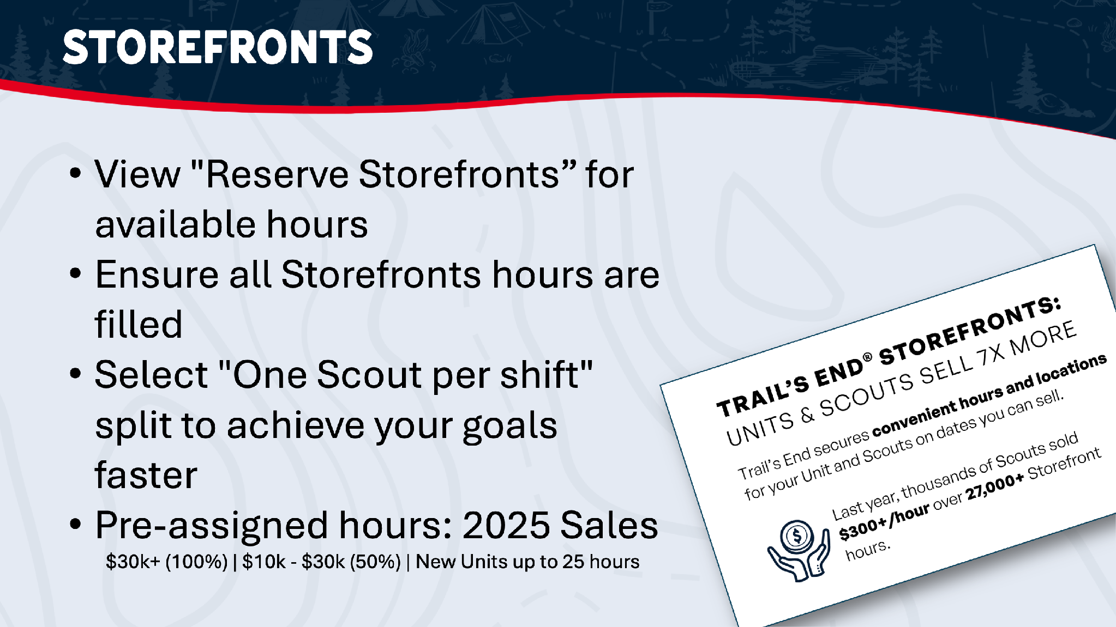

Slide 7
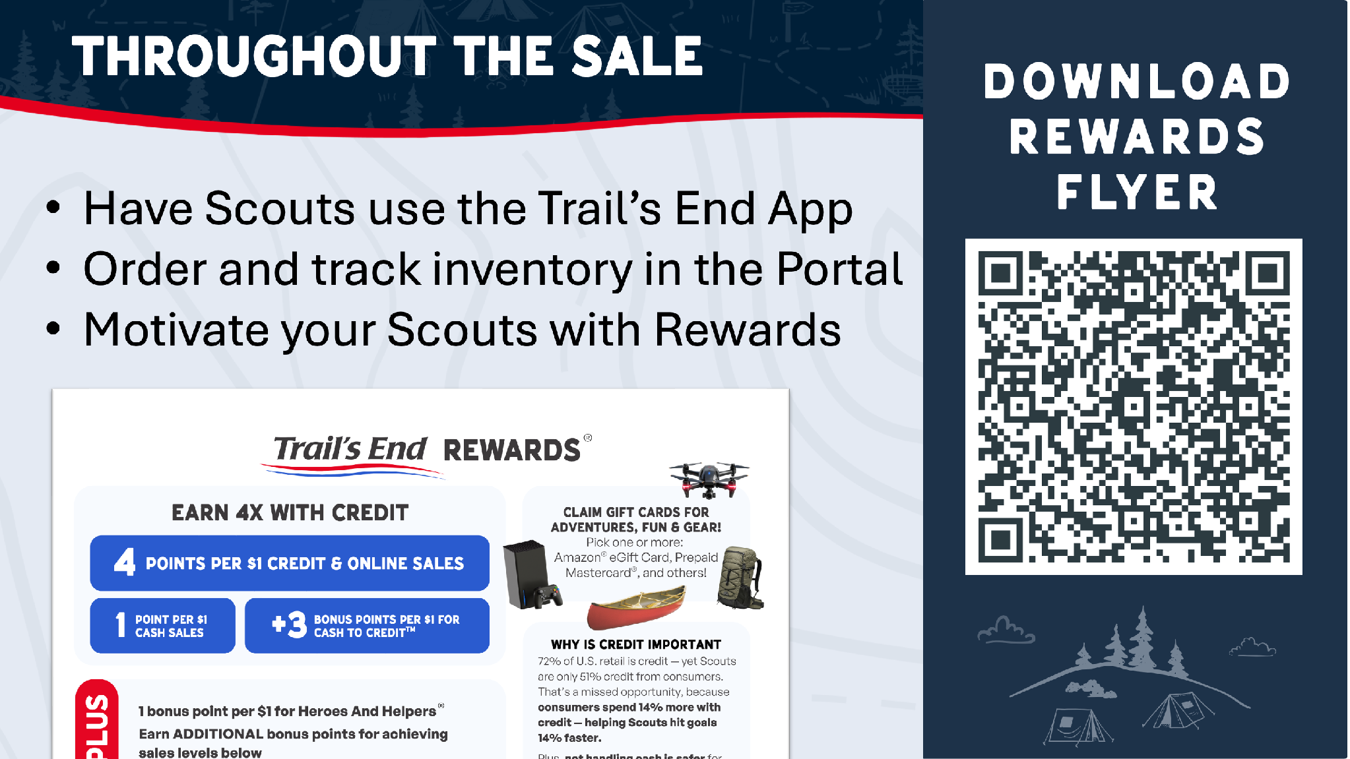

Slide 8
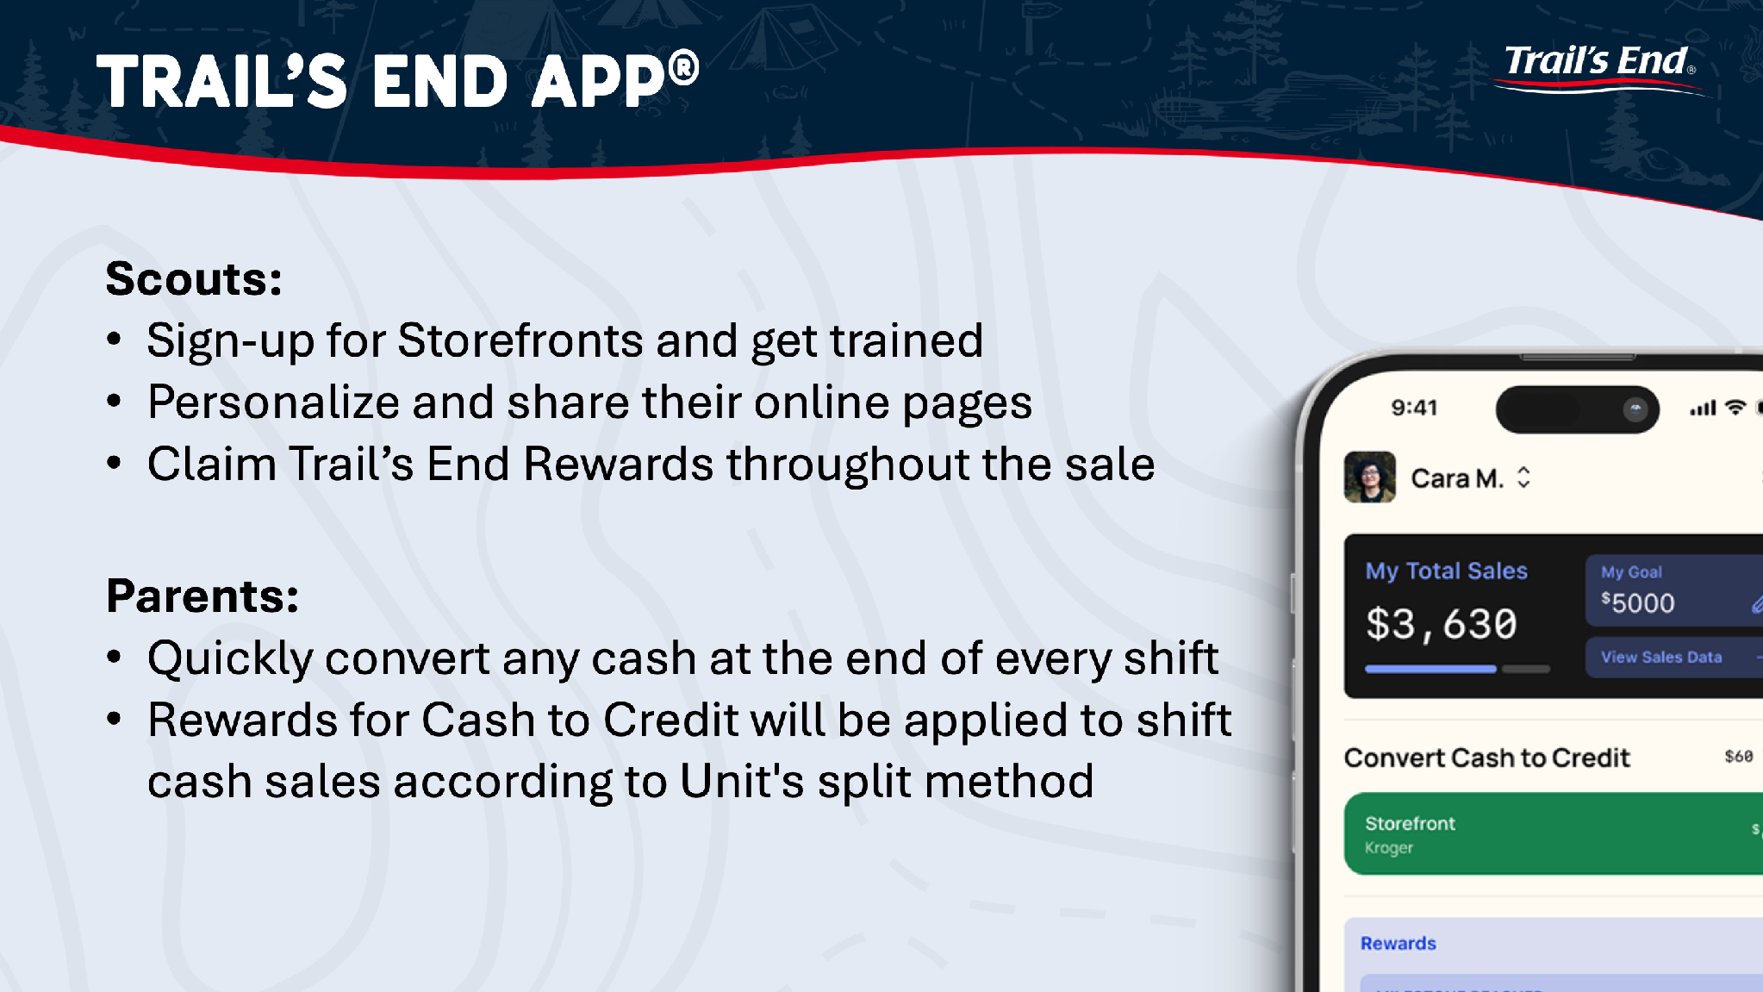

Slide 9
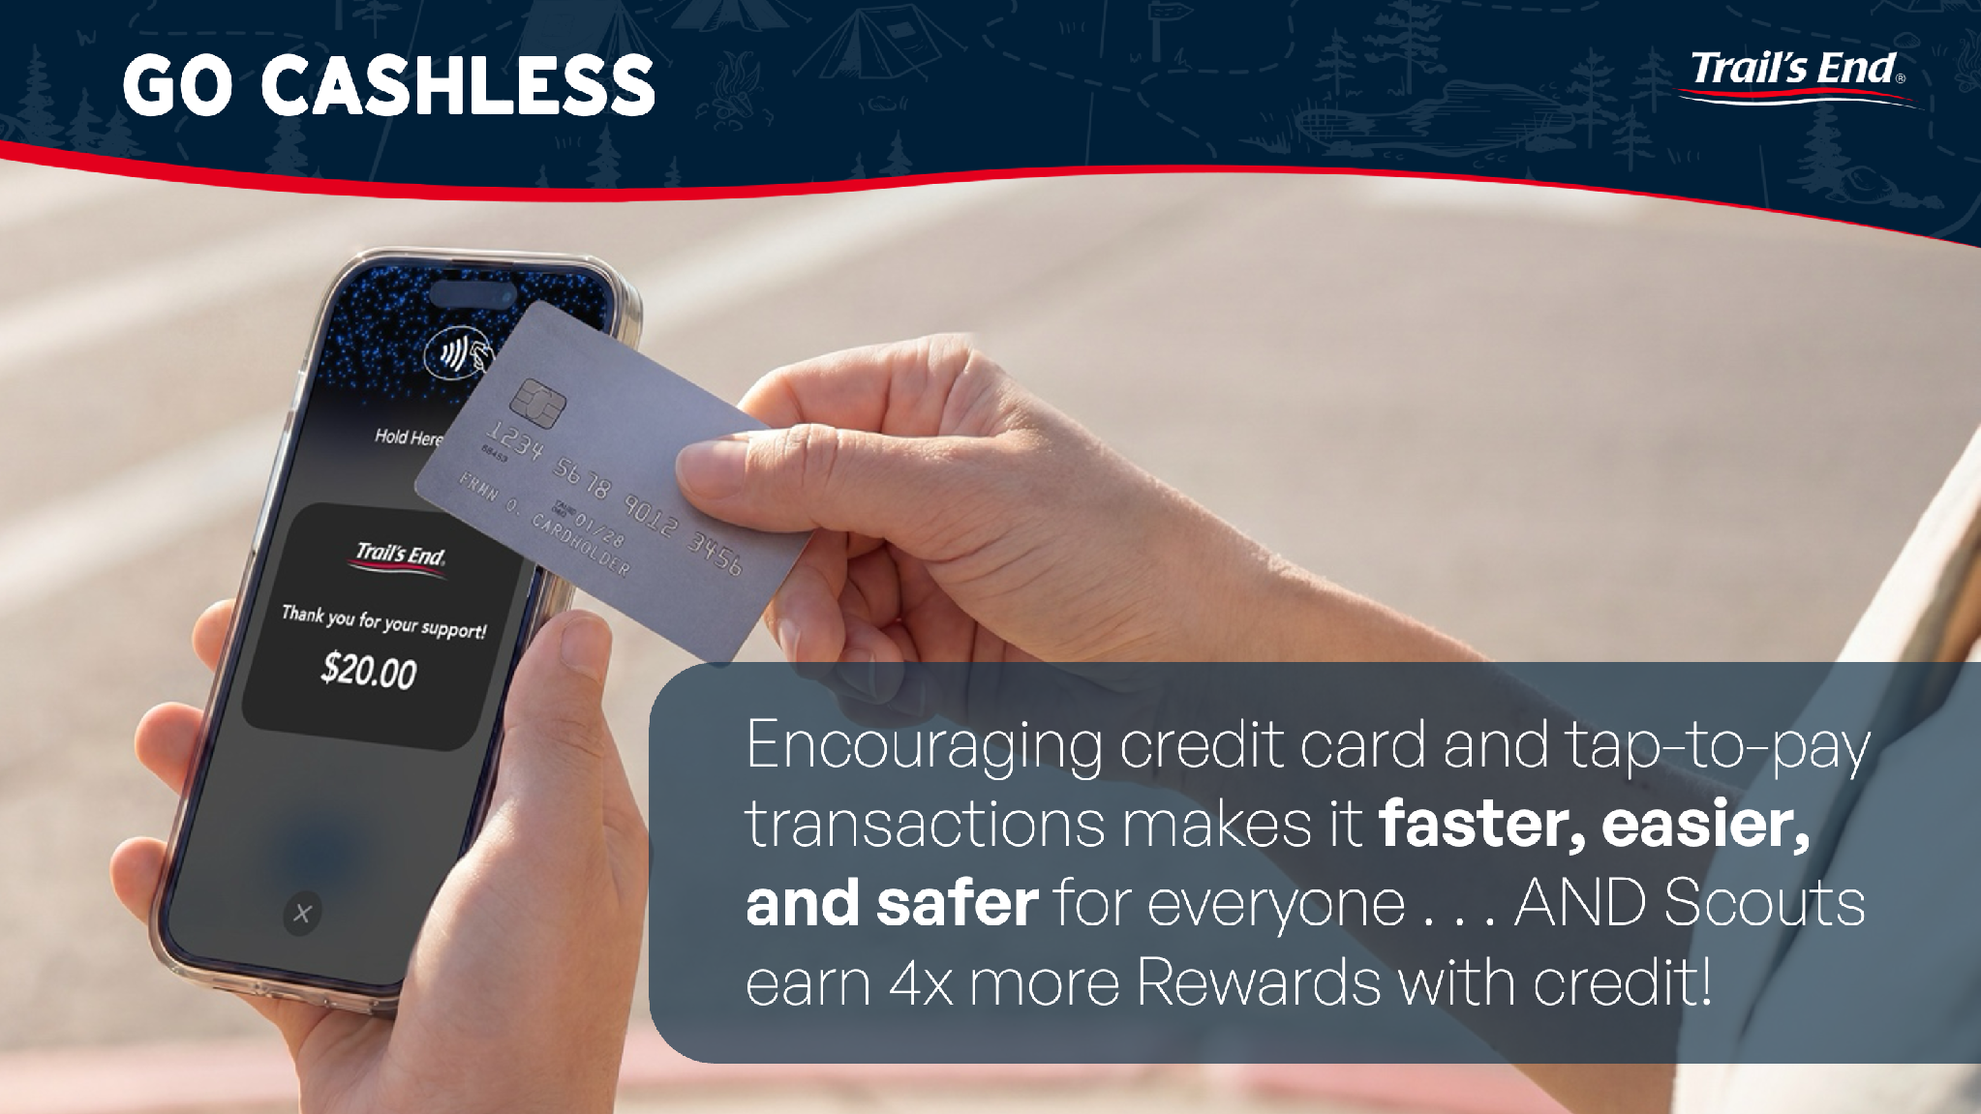

Slide 10
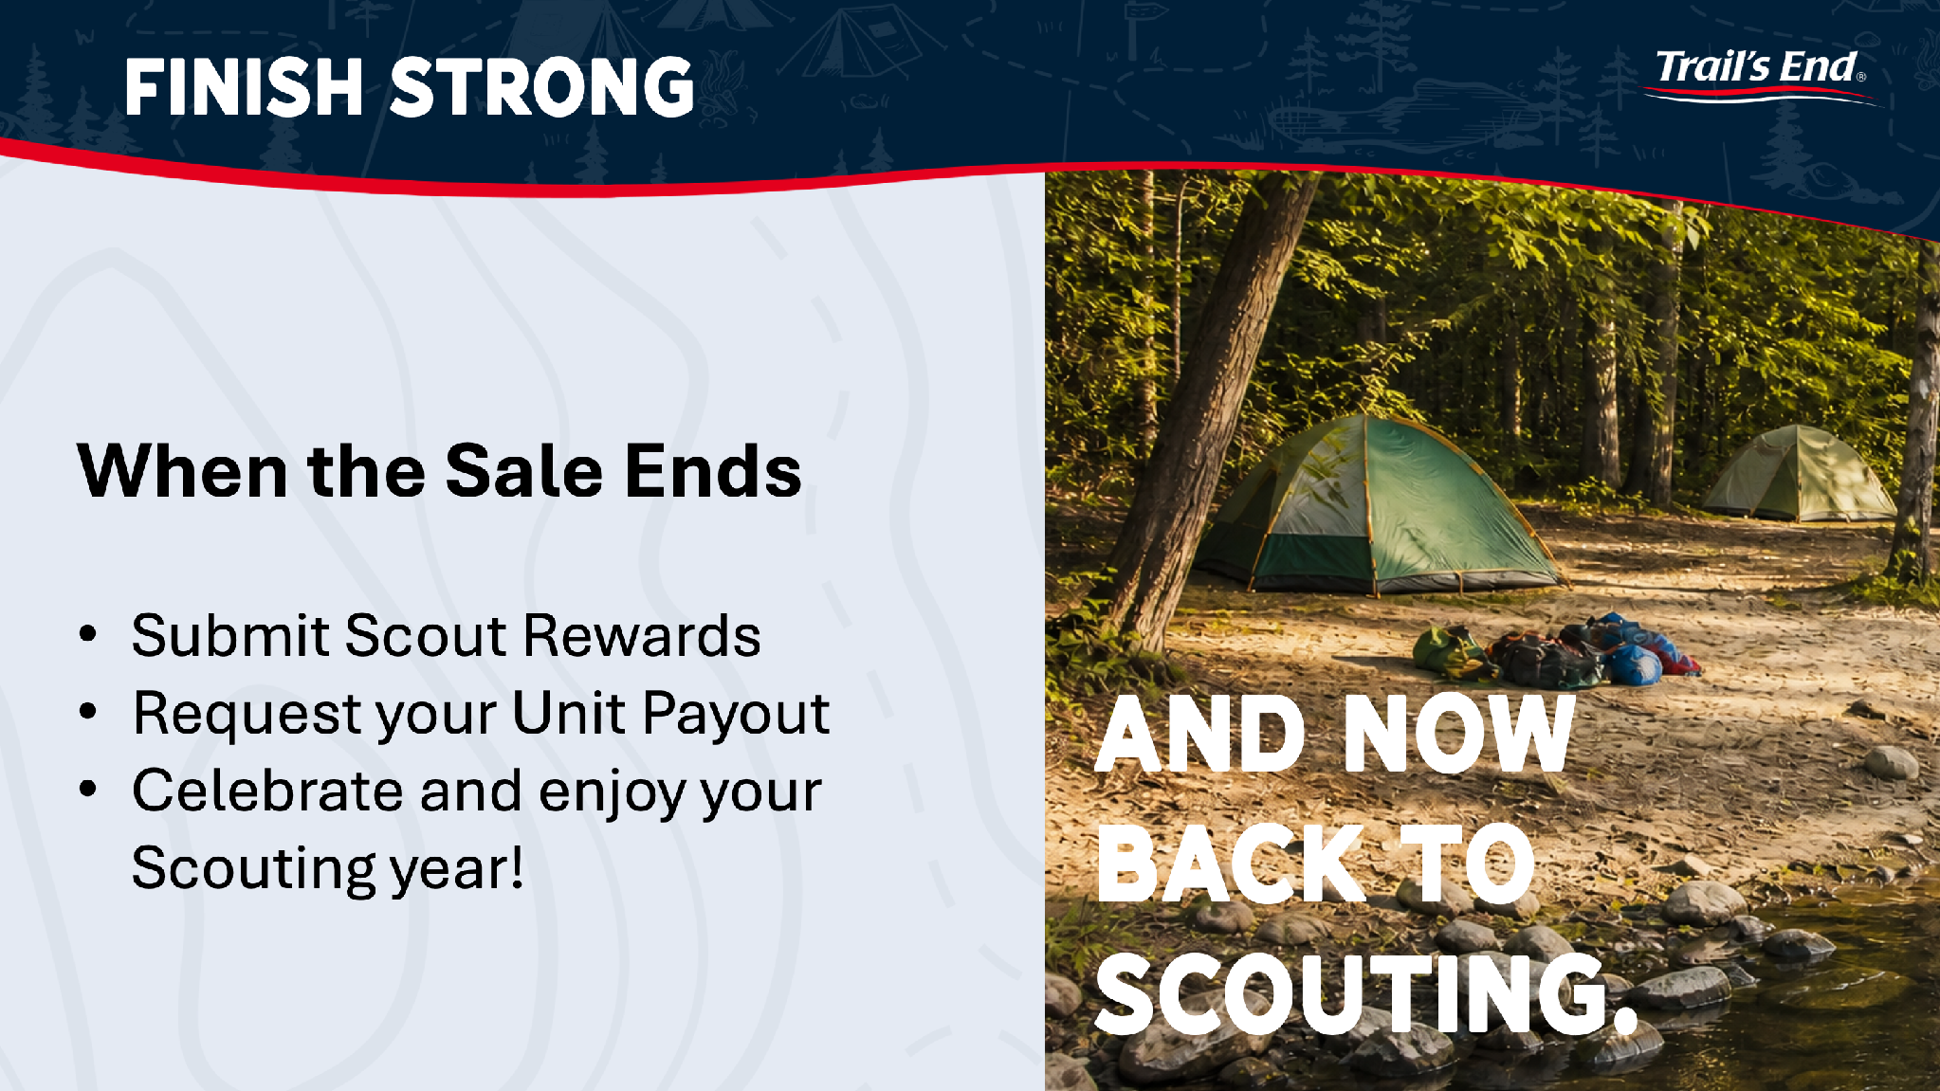

Slide 11
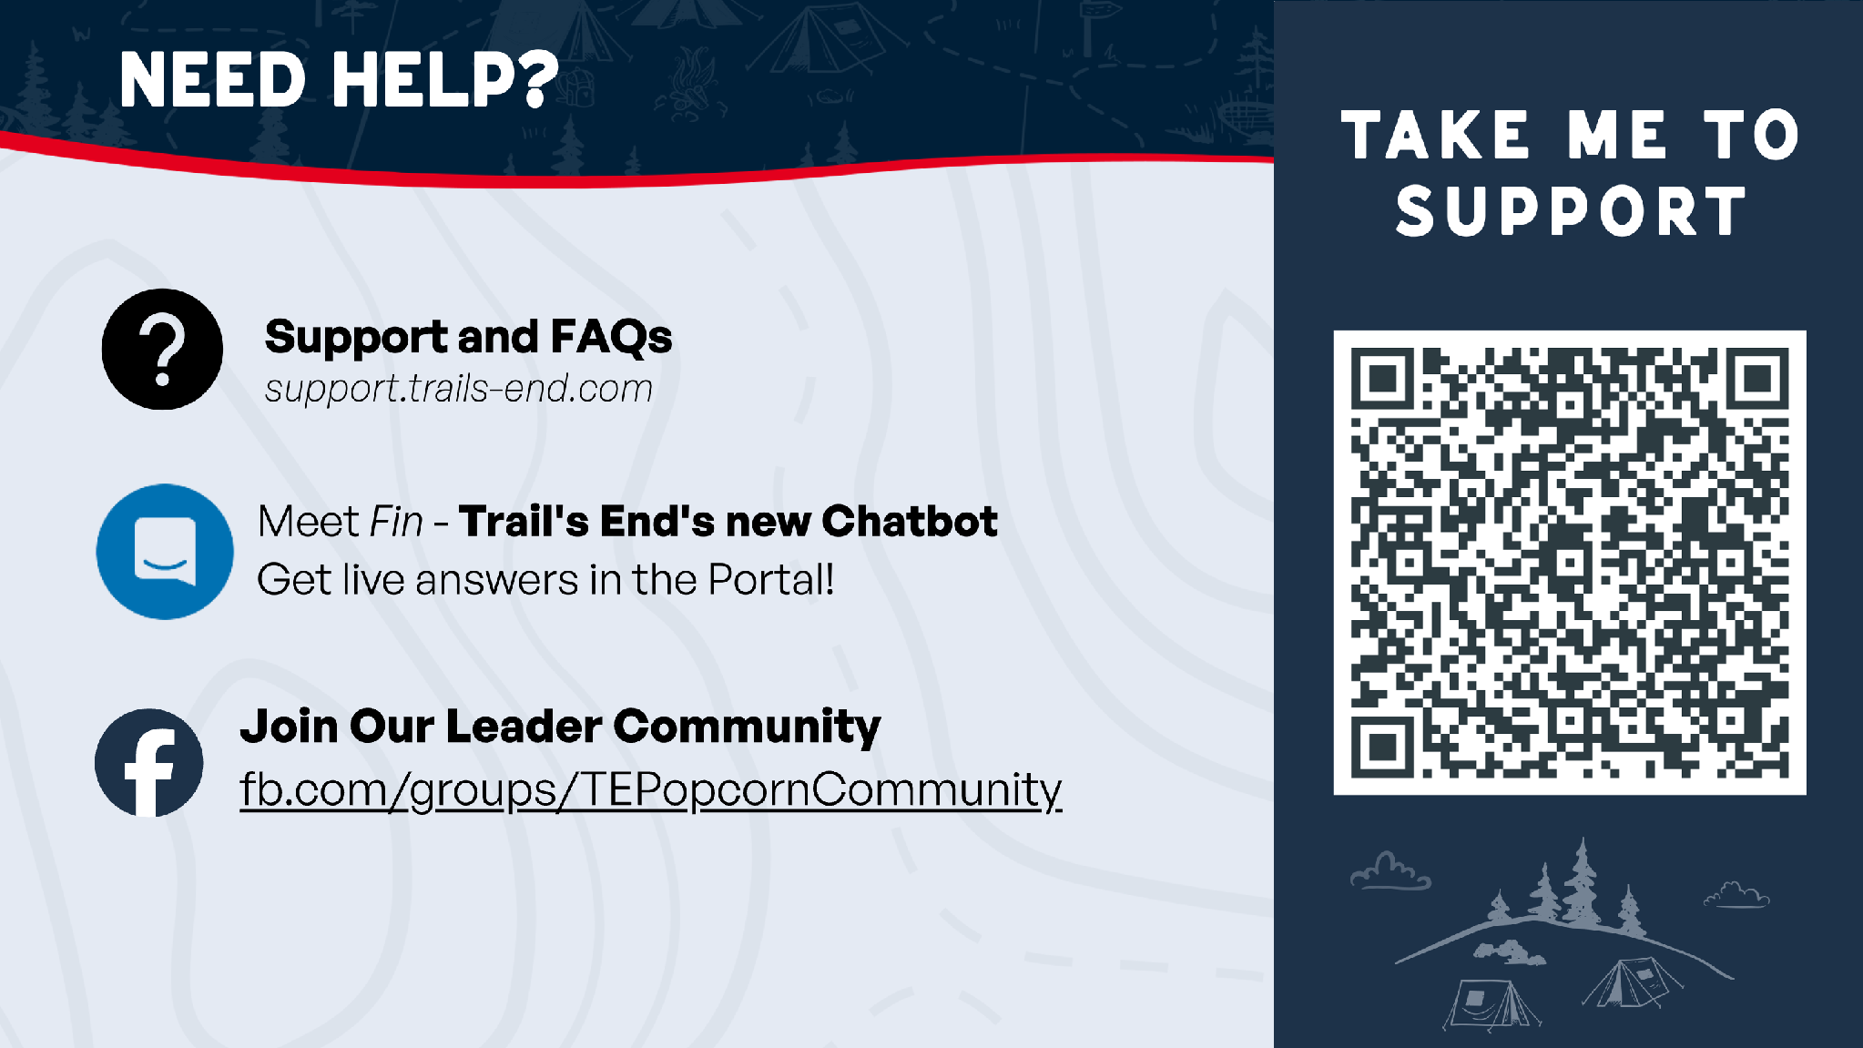

Slide 12


Storefront Escalation
If a unit arrives at a storefront location and the manager requests proof of authorization the leader should:
Log in to the Leader Portal and navigate to Storefronts
Click on the specific storefront reservation
Open the Details tab and look for Storefront Agreements
Click the PDF file name to view or download the confirmed agreement on the spot
If the store manager still does not allow the Unit to set up, please have the Unit leave respectfully and immediately notify Trail’s End Support so we can follow up with the venue. We have staff working weekend blocks on standby to assist. The faster they’re brought into the conversation, the more quickly we are likely able to resolve the problem.

Slide 13
Damaged Product
If a Unit opens a case and finds damaged product, they should immediately email support@trails-end.com for an invoice credit and reach out to the council directly for replacement product.
When emailing support, the unit must include:
  The Damage (for each item, if multiple)
  The best-by date and lot code printed on the bag, container, or case
  Unit type and number (e.g., Pack # or Troop #)
  Product type and quantity affected
  Clear photos showing the damage

Slide 14
Onboarding
Finish your onboarding!
Onboarding opens your unit to all the great resources Trails End has to offer.
These steps include: Setting a goal, establishing a storefront area, blackout dates, and getting paid!
Complete the steps, secure storefronts, and get selling!

Slide 15


Slide 16
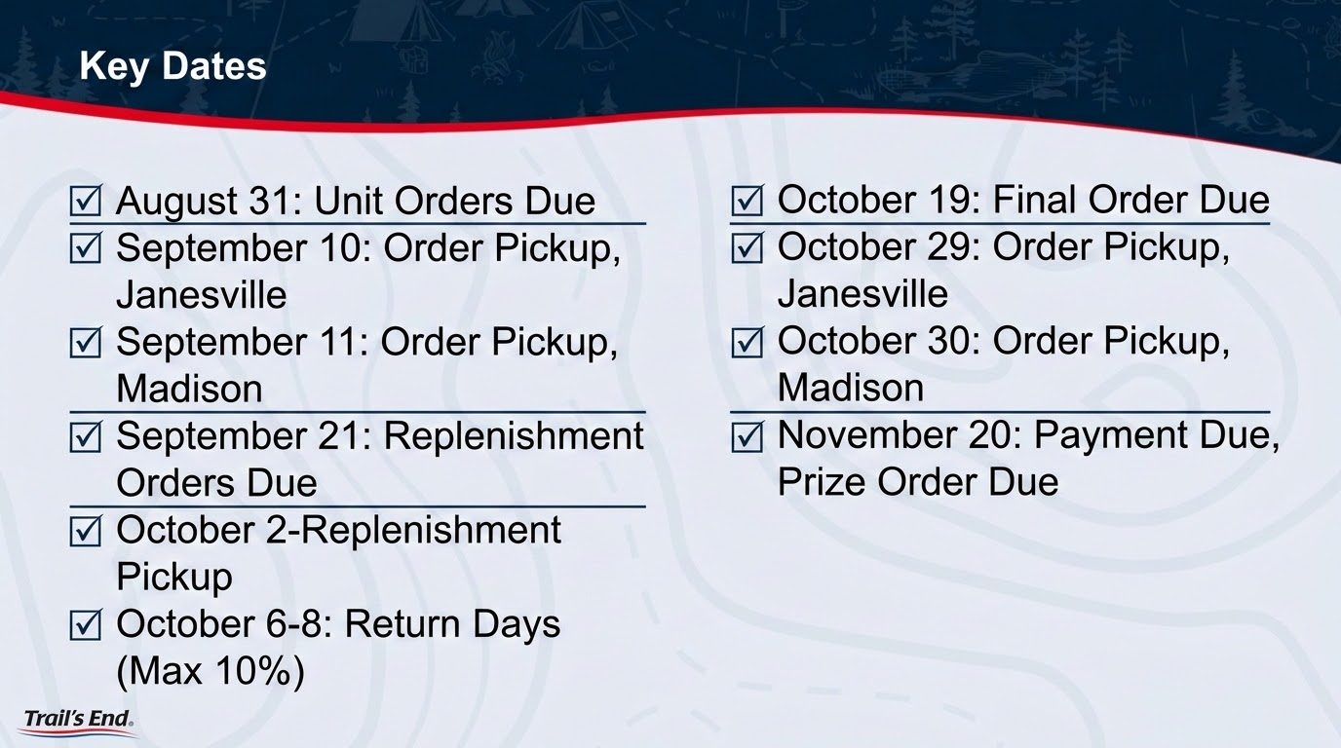

Slide 17
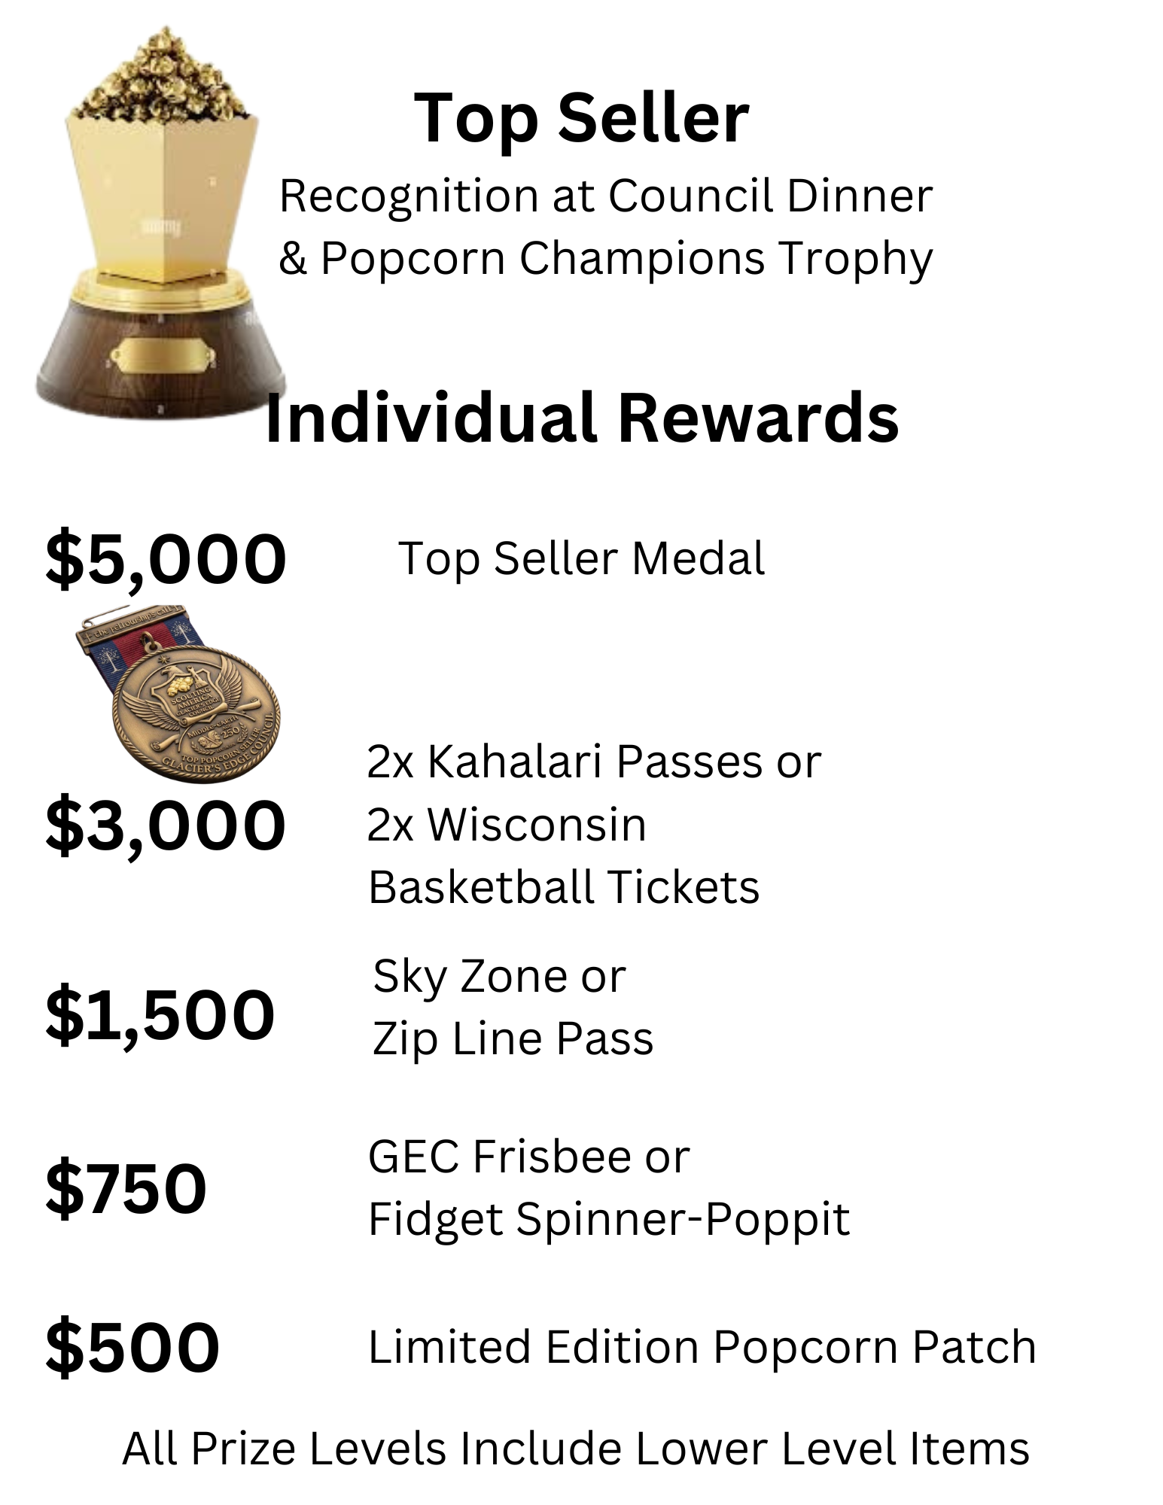
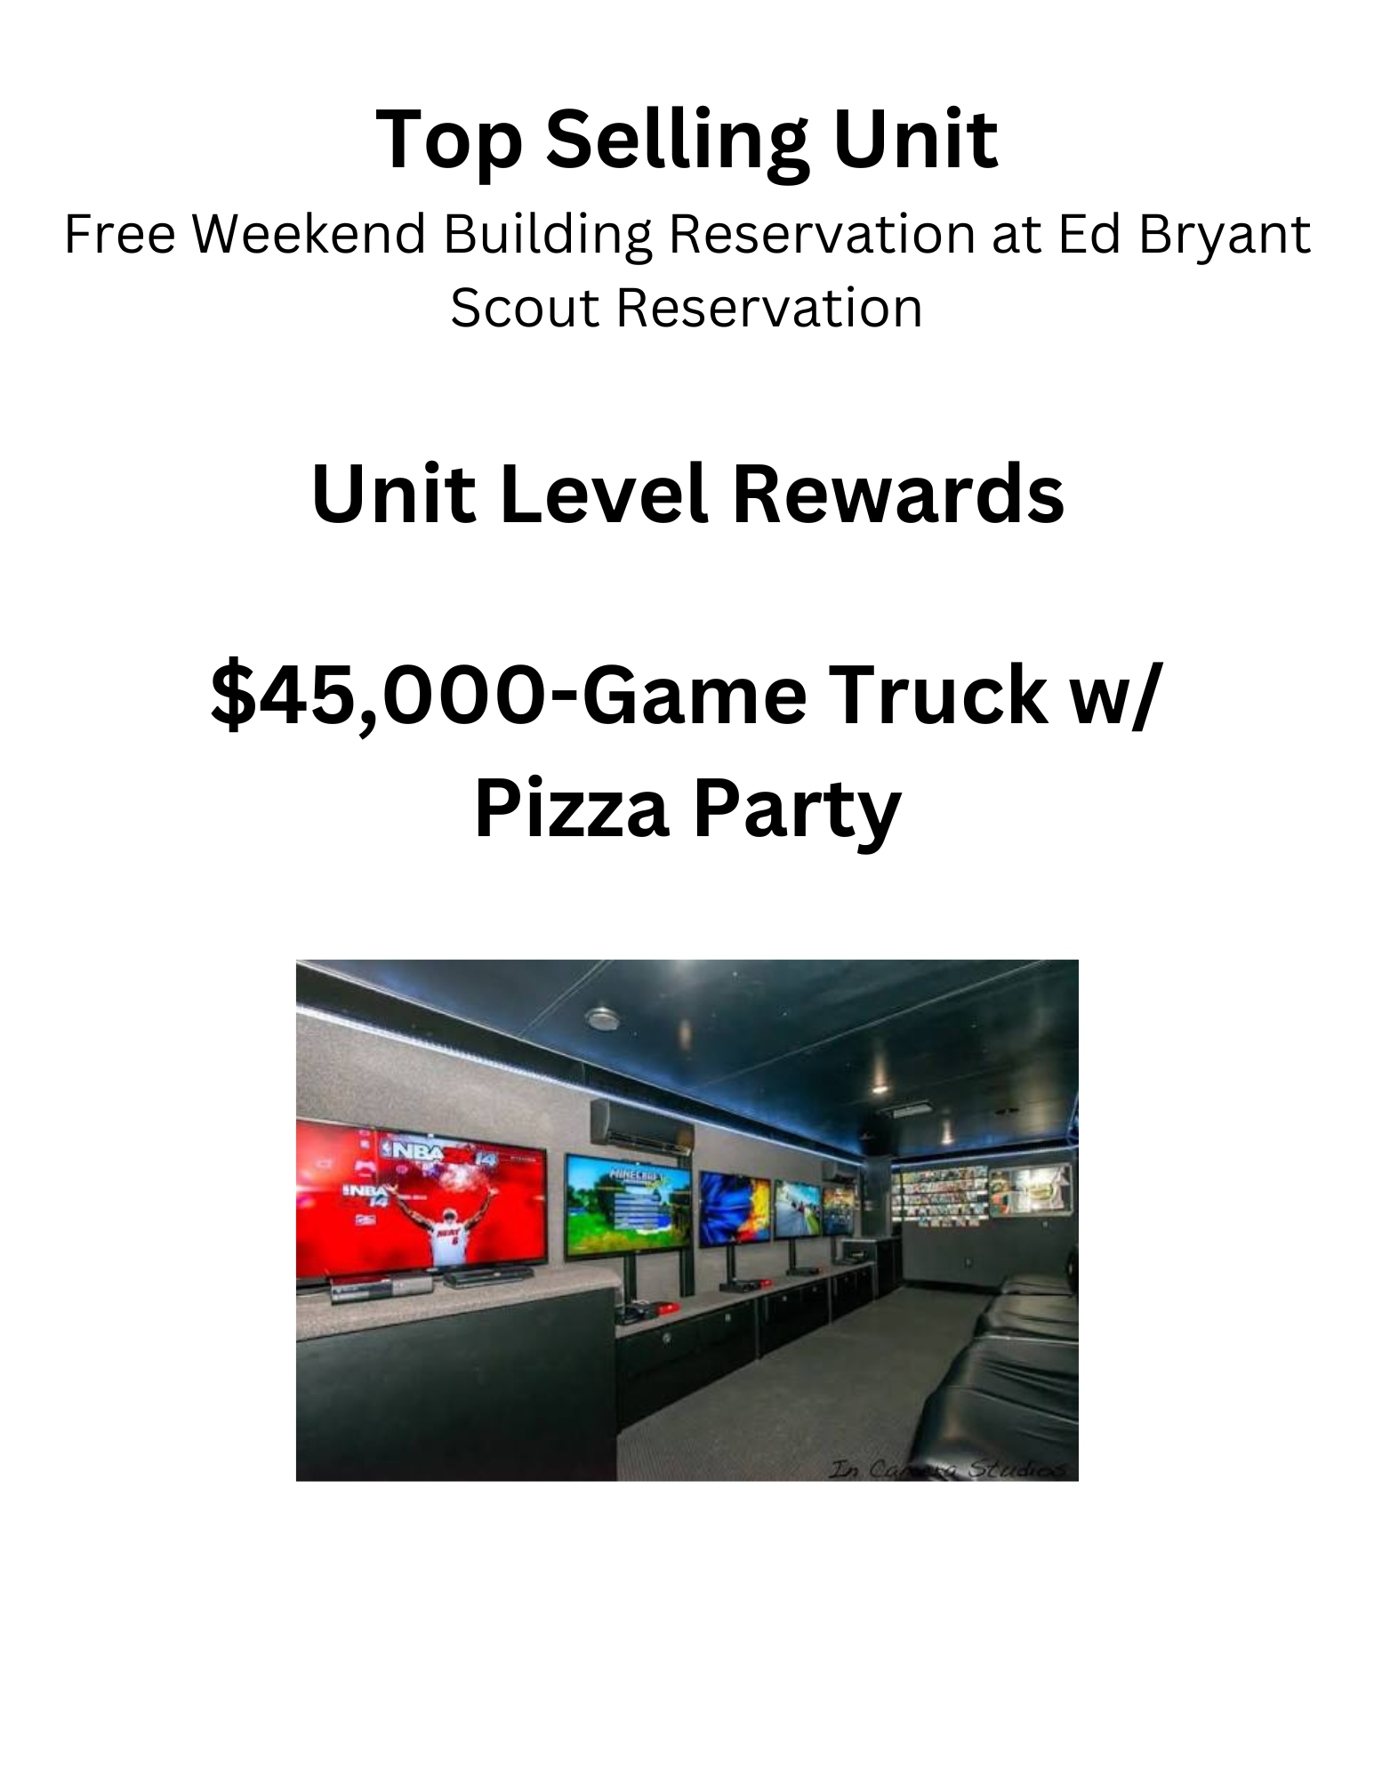
Council Prizes

Slide 18

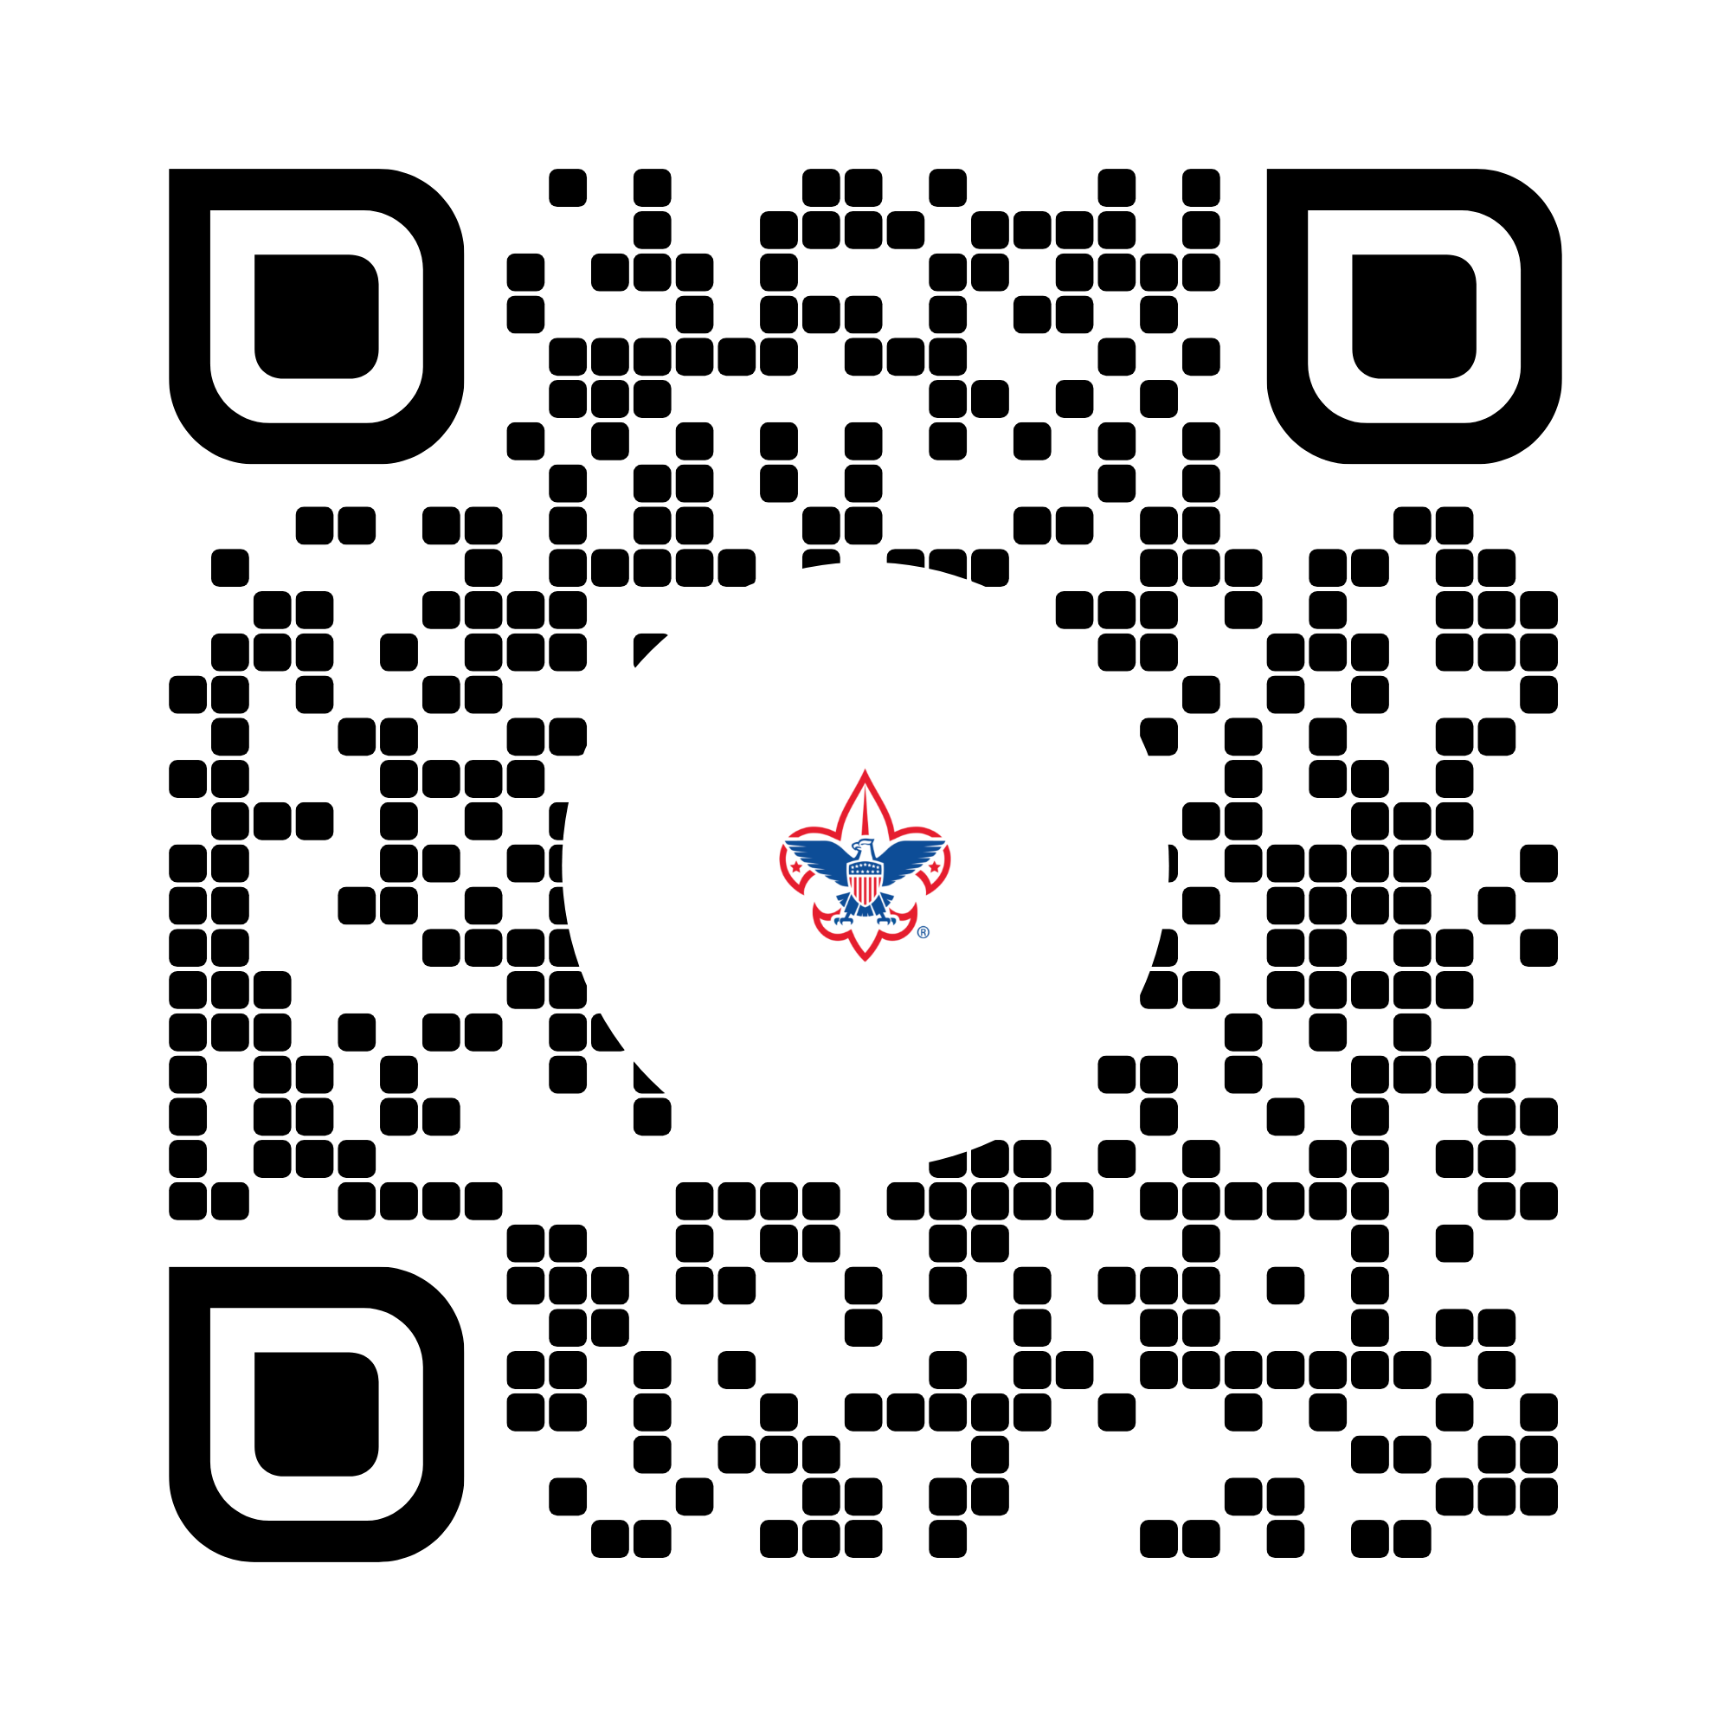
The Theme
Kernel Journal

Slide 19
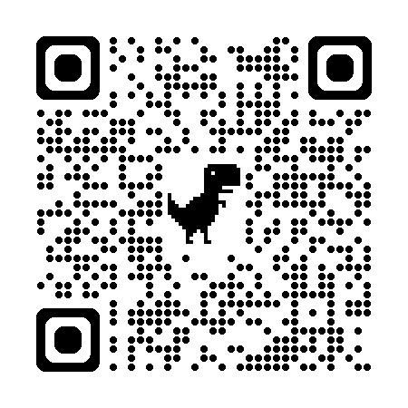

Other Happenings
September 10: Wreath Sale Begins
October 28: Unit Orders Due
November: Wreath Pick Up
Nov 11th: 1-6pm at GEC Office
Nov 10th: 1-6pm at Clark’s Greenhouse, Edgerton
November 24: Replacements/Add-ons Due
[Noble Valley items only]
Replacement/Add-On Pick Up: Date To be announced
December 4: Payment Due to Council

